Slide 1
SQL Schema Overview for Film Rental System
-Understanding the Structure and Relationships of the Database.
-Presenter : Ahmed Mousa.
-Date : 10/10/2024.

Slide 2
Objective :-
-To provide a comprehensive overview of the SQL schema for the film rental system.
- To explain the tables, their attributes, and relationships within the database.

Slide 3
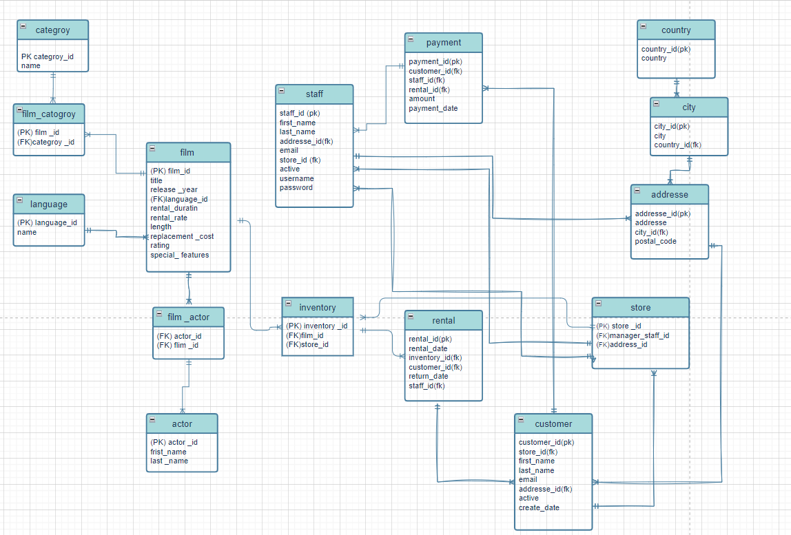
Diagram : -The schema represents the structure of the film rental database. - It includes various tables to manage films, customers, rentals, payments, and staff.

Slide 4
SQL Questions

Slide 5
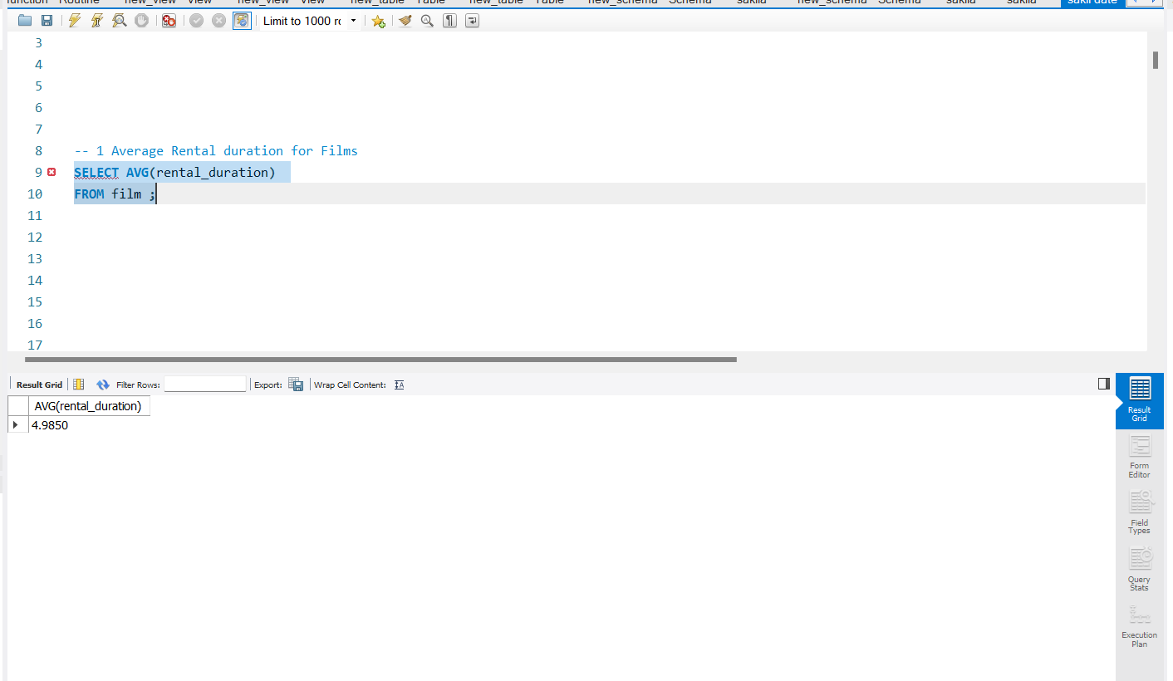
1 -Average Rental duration for Films

Slide 6
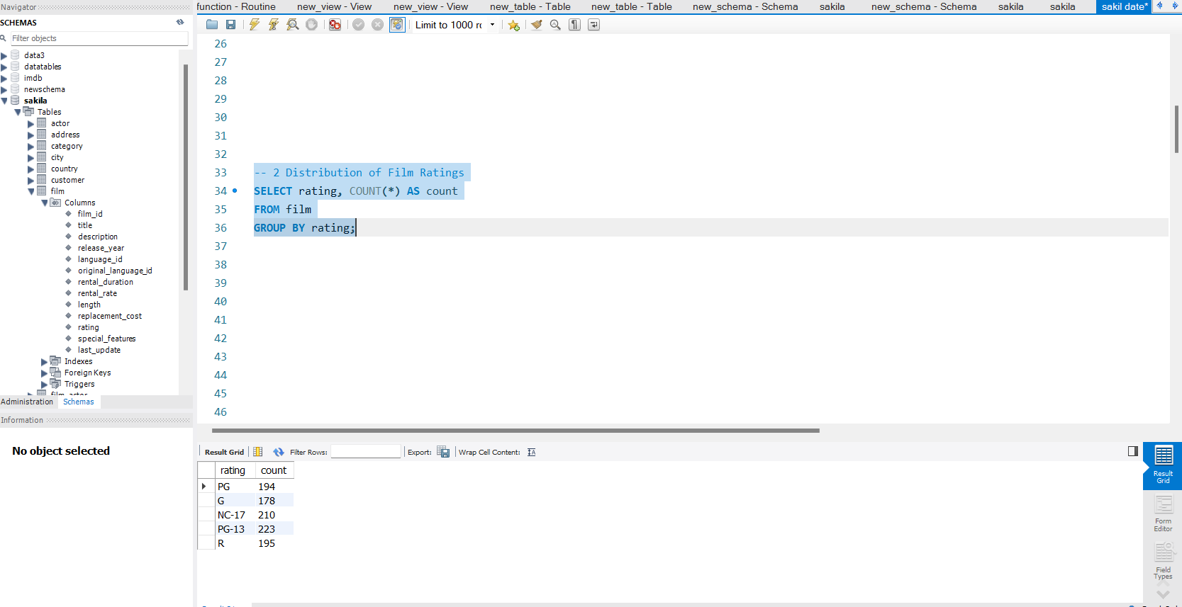
2-Distribution of film Rating

Slide 7
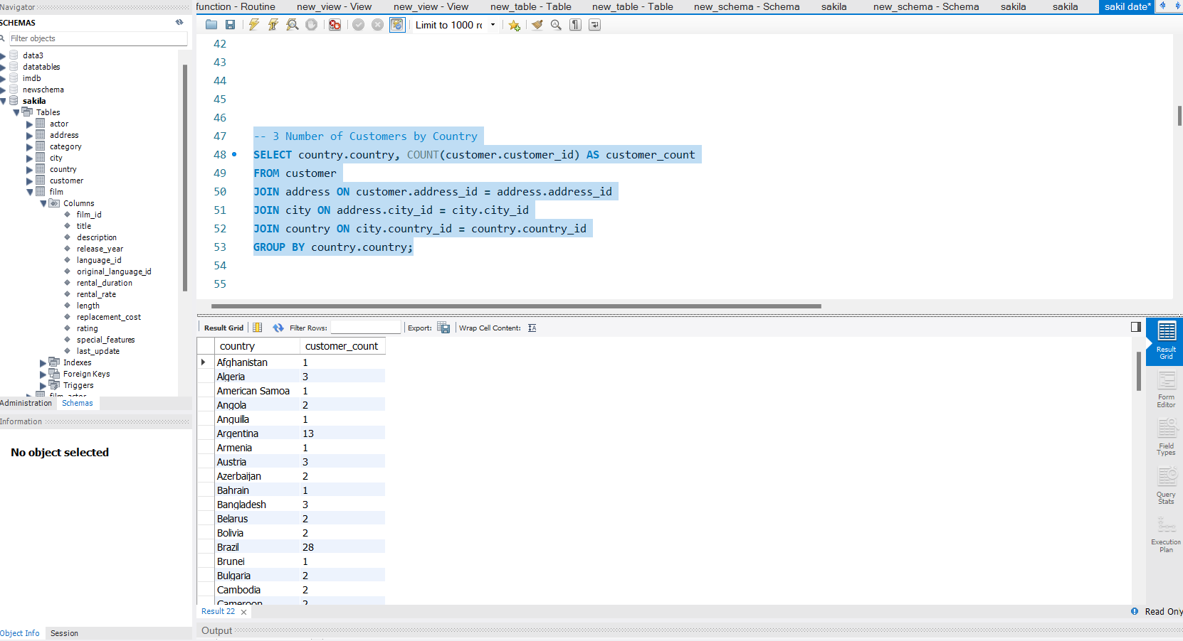
3-Number of Customer By country

Slide 8
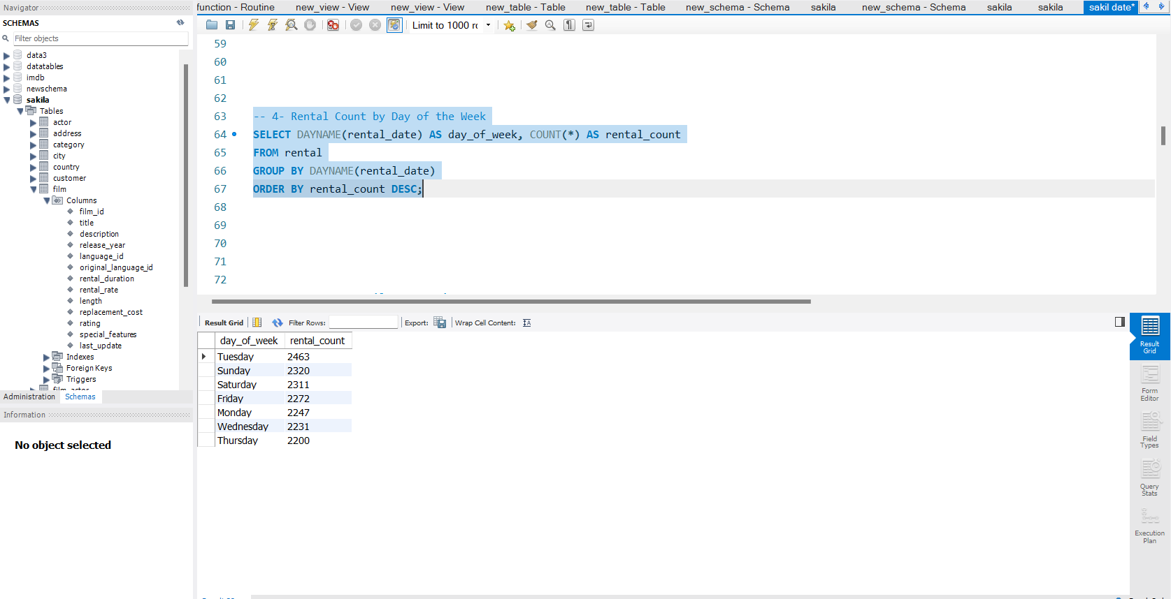
4-Rental Count by day of week

Slide 9
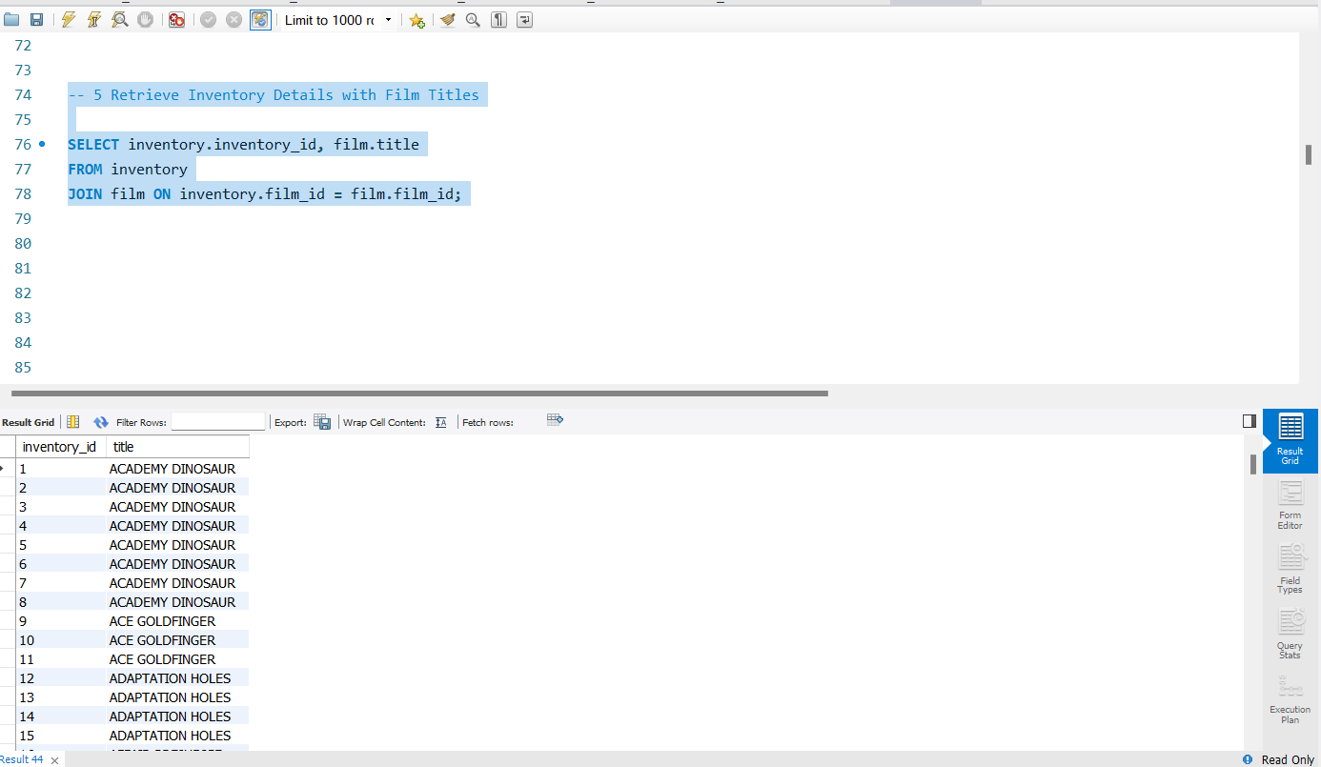
5-Retrieve inventory with film titles

Slide 10
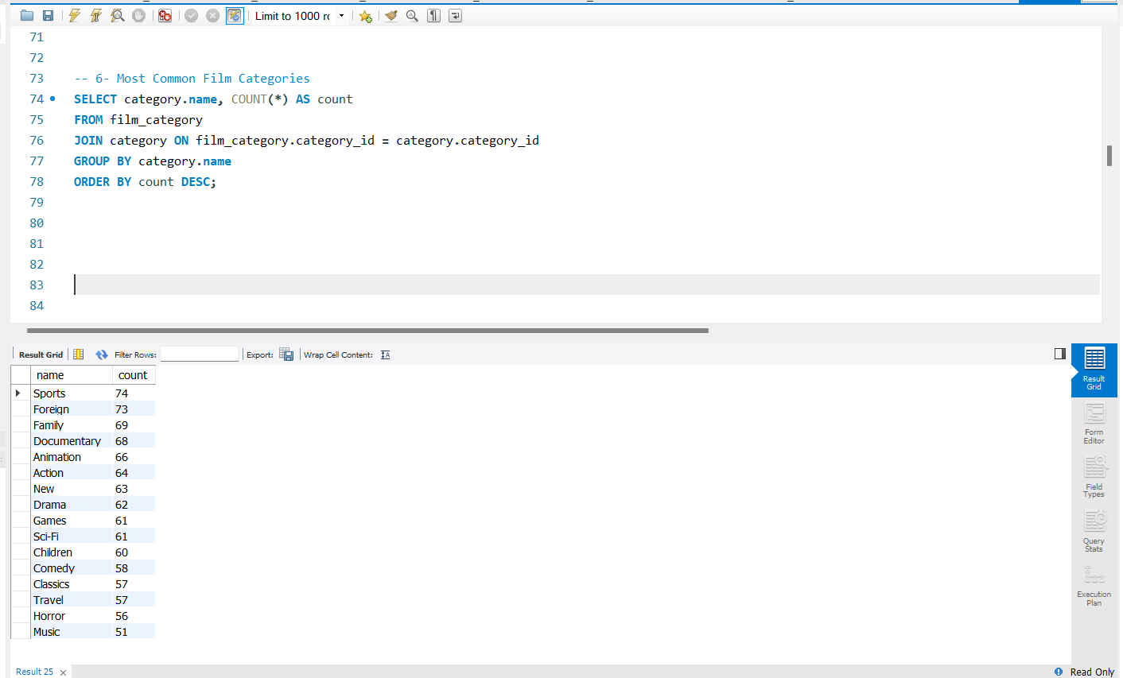
6-Most common film categories

Slide 11
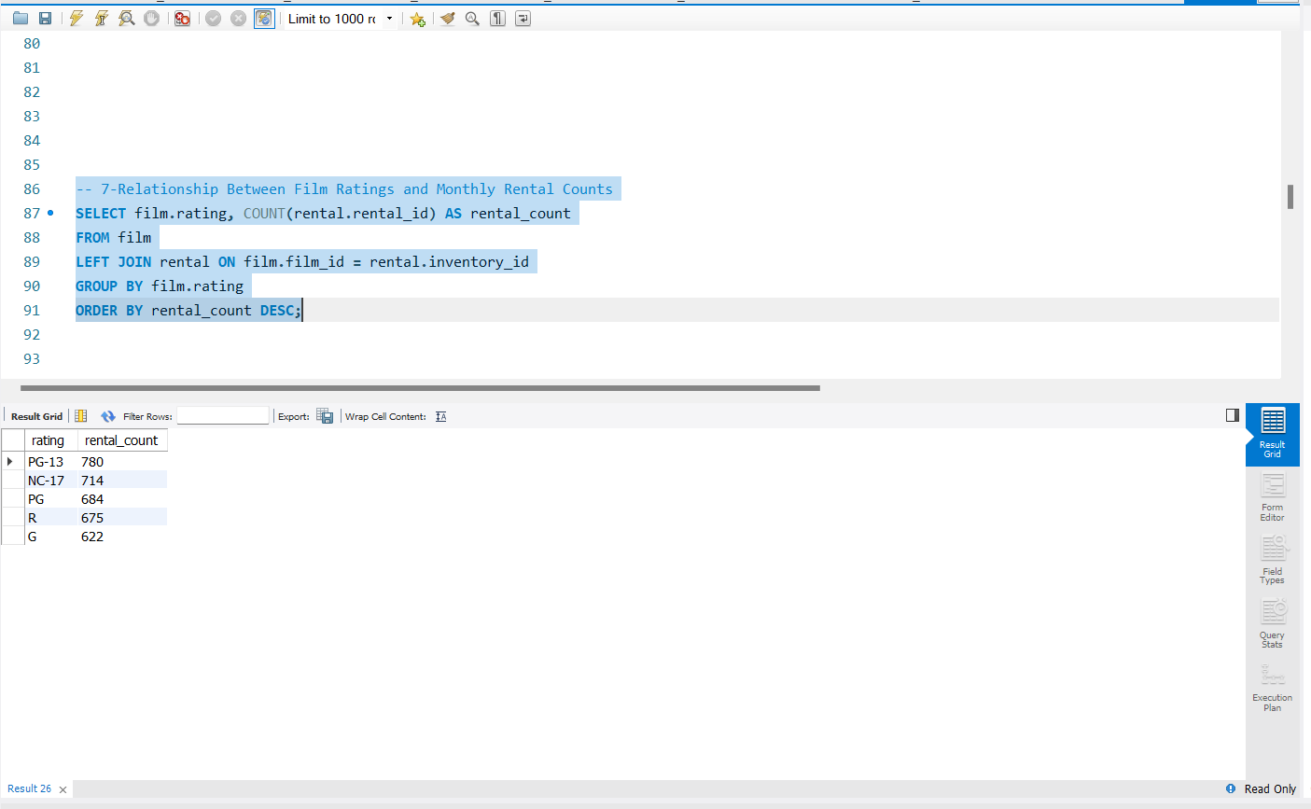
7-Relationship Between Film Ratings and Monthly Rental Counts

Slide 12
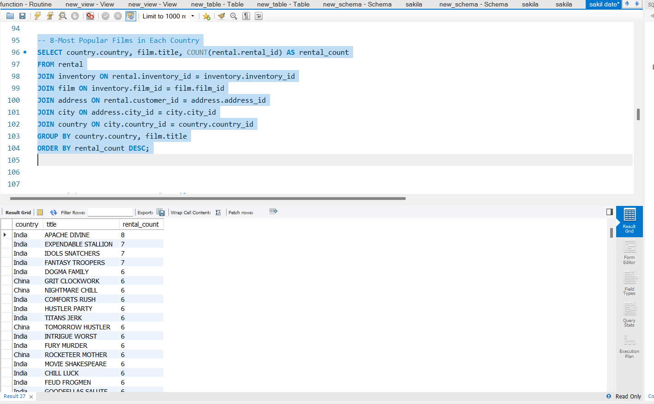
8-Most Popular Films in Each Country

Slide 13
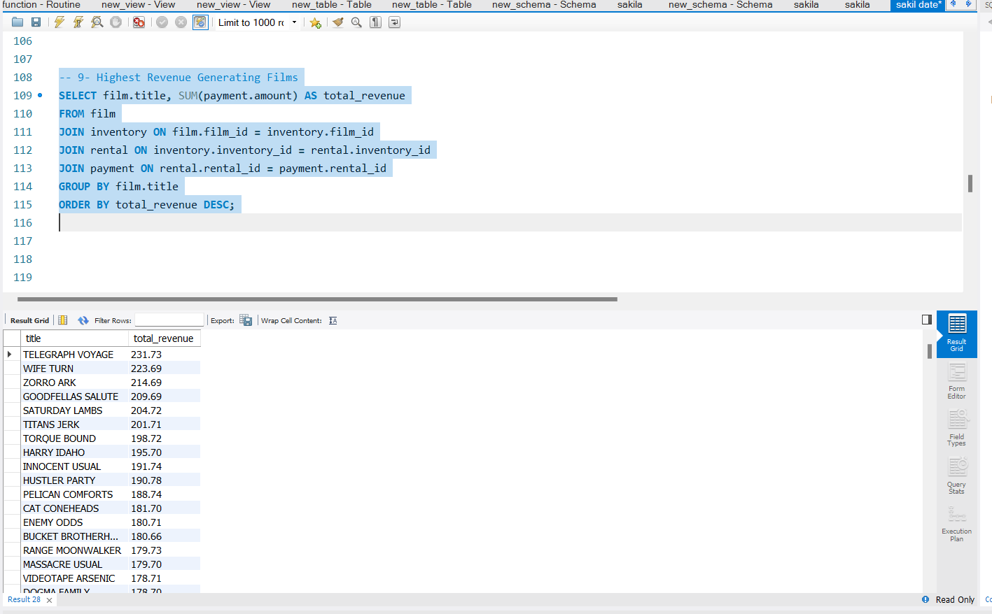
9- Highest Revenue Generating Films

Slide 14
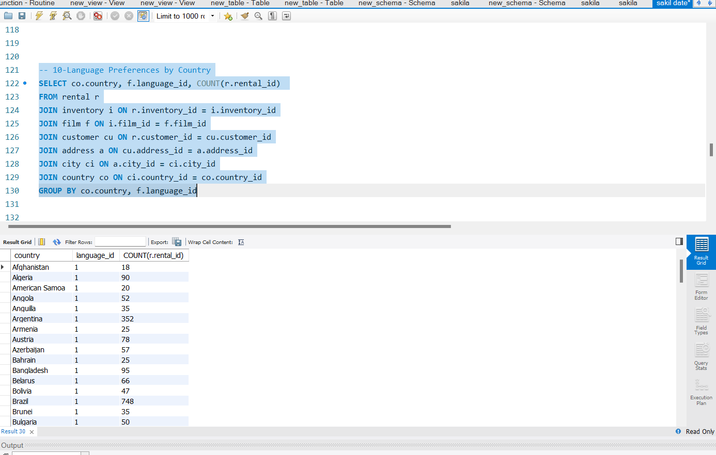
10-Language Preferences by Country

Slide 15
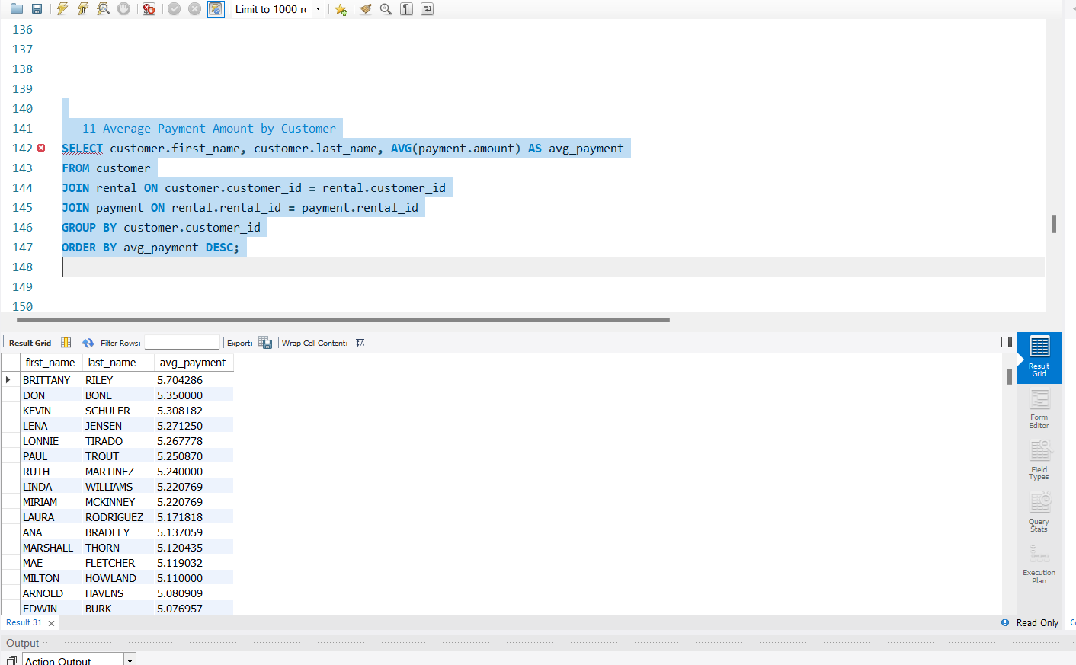
11 -Average Payment Amount by Customer

Slide 16
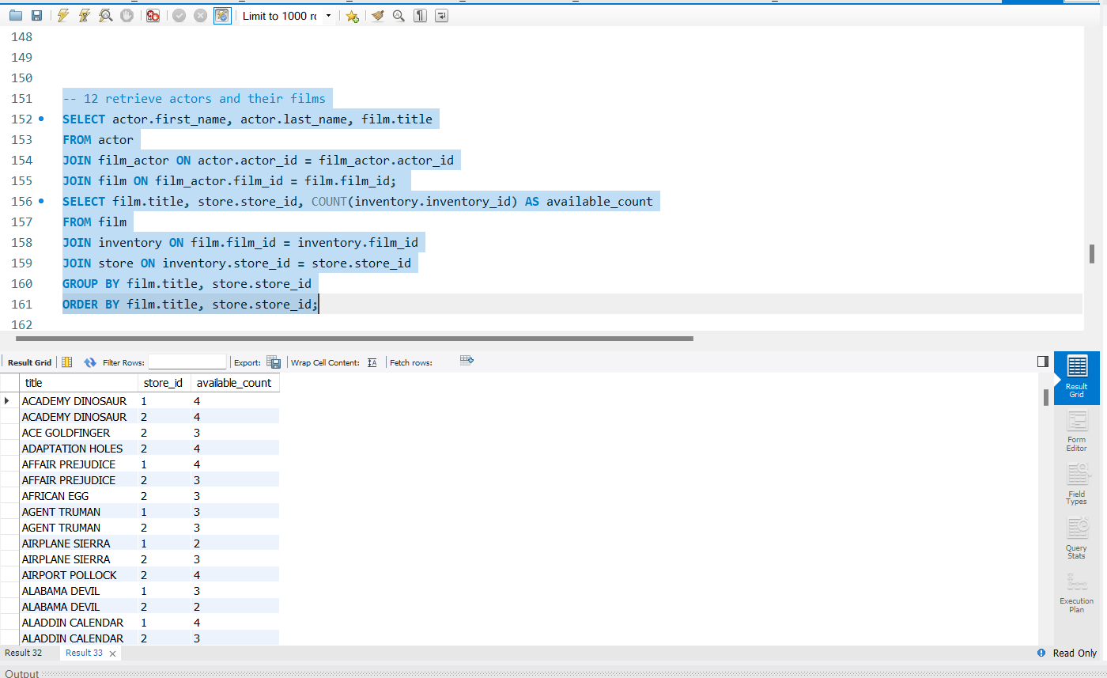
12- retrieve actors and their films

Slide 17
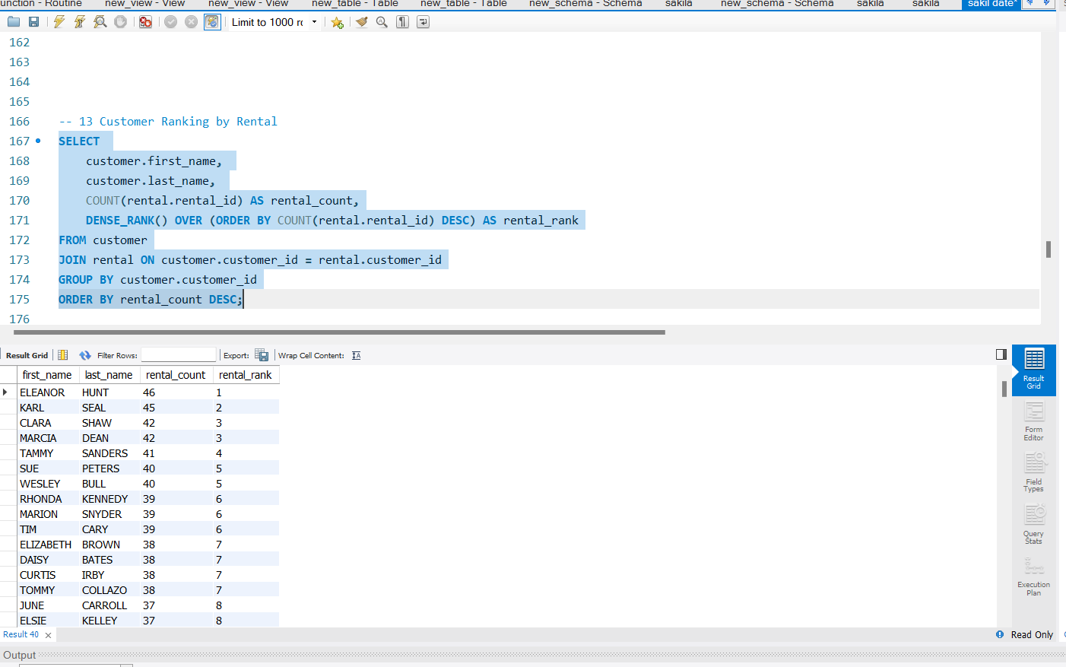
13- Customer Ranking by Rental

Slide 18
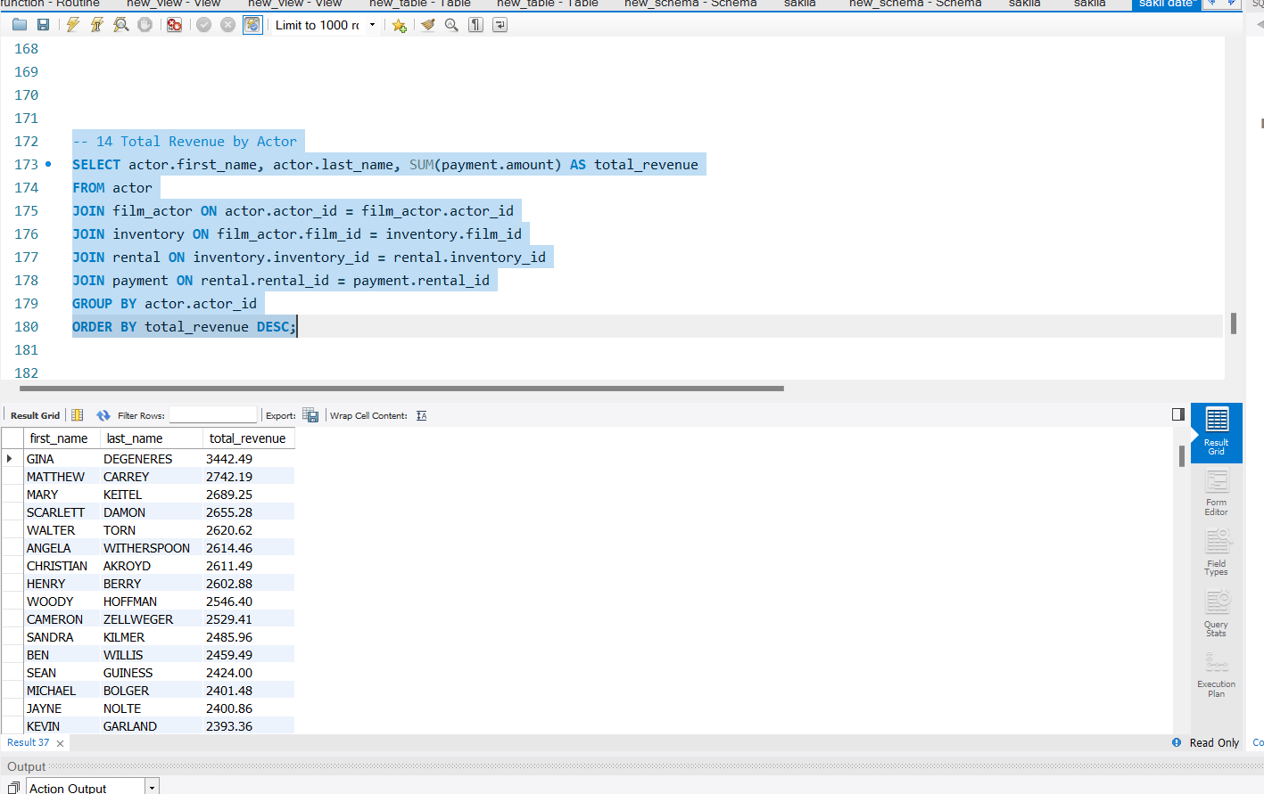
14 -Total Revenue by Actor .

Slide 19
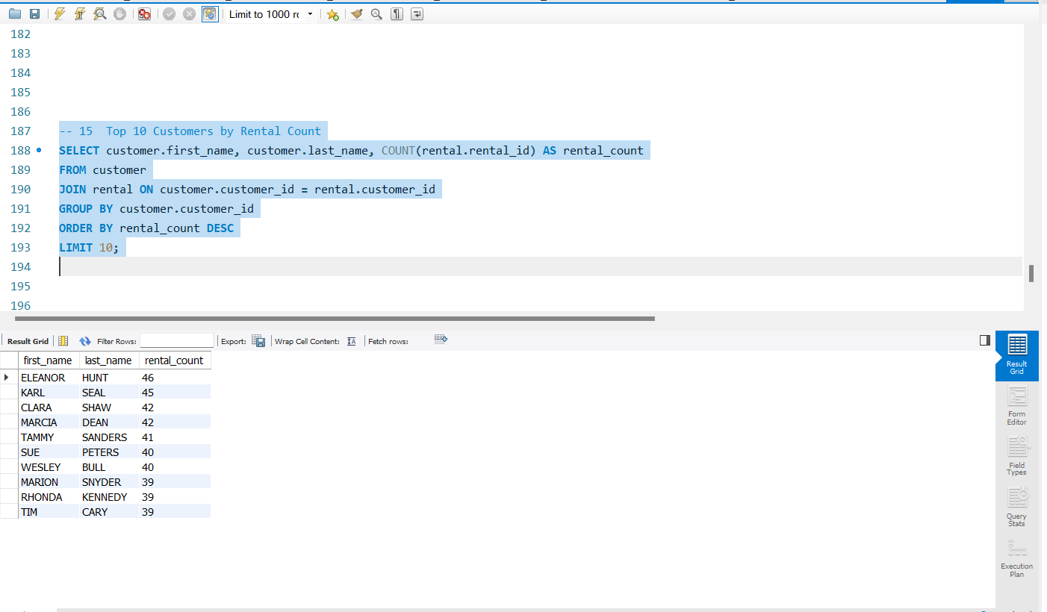
15 -Top 10 Customers by Rental Count .

Slide 20
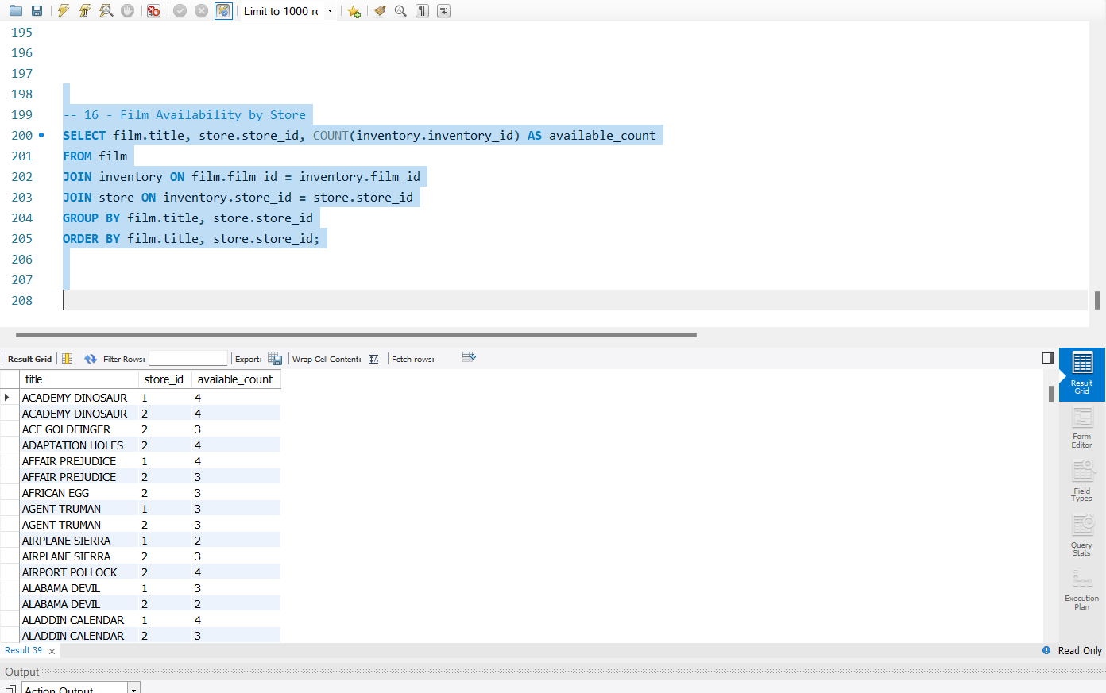
16 - Film Availability by Store .

Slide 21
Thank you!
The End

